Slide 1

Questor: Your AI Study Assistant
Introducing Questor: Revolutionizing exam preparation with an AI Chat Bot. Questor offers personalized learning, instant answers, and 24/7 availability. It's designed for students across all disciplines preparing for exams.

Slide 2
Meet the Questor Team
Team Lead: Rajesh
Coding: Rajeshwari
Coding: Priyamadhuri
Documentation: Naseema
Documentation: Narendra Babu

Slide 3
Questor: Project Abstract
Problem
Solution
Methodology
Expected Outcomes
Students face challenges in exam preparation. These challenges include lack of time and resources.
Questor chatbot provides accessible, personalized study assistance anytime.
Utilizes NLP and machine learning for efficient learning and support.
Improved student performance and enhanced learning experiences.

Slide 4
Questor: Advantages & Disadvantages
Advantages
Disadvantages
24/7 availability and instant support.
Requires internet access.
Personalized learning experience.
Potential for over-reliance/reduced critical thinking.
Cost-effective compared to traditional tutoring.
Accuracy dependent on training data.
Wide range of subjects and exam types.
Cannot replace human interaction.

Slide 5
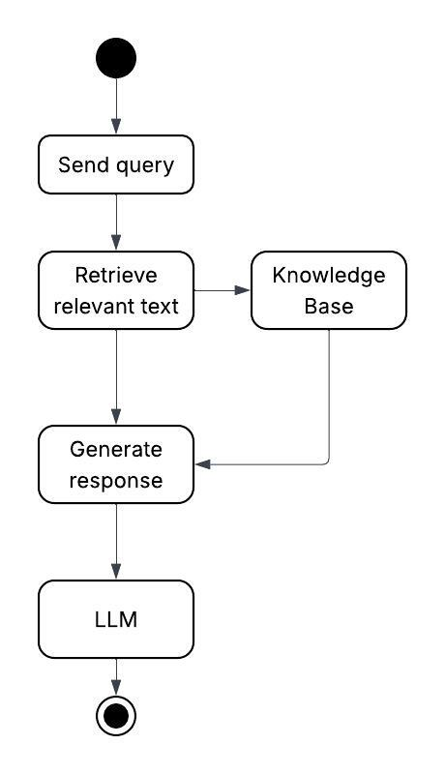
ACTIVITY UML

Slide 6
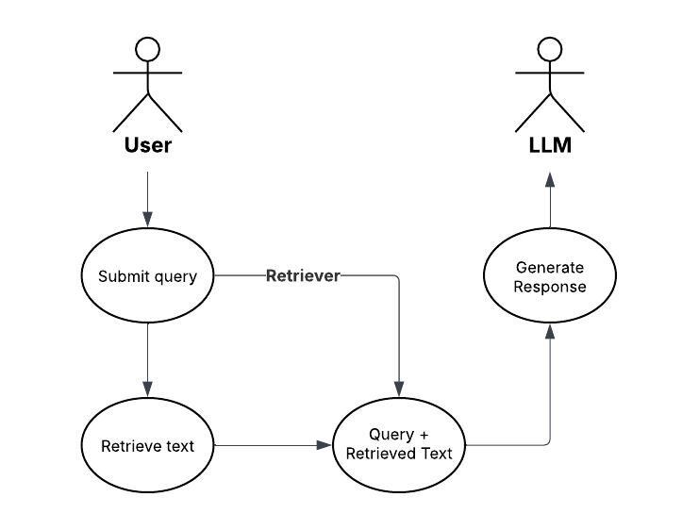
USE CASE UML

Slide 7
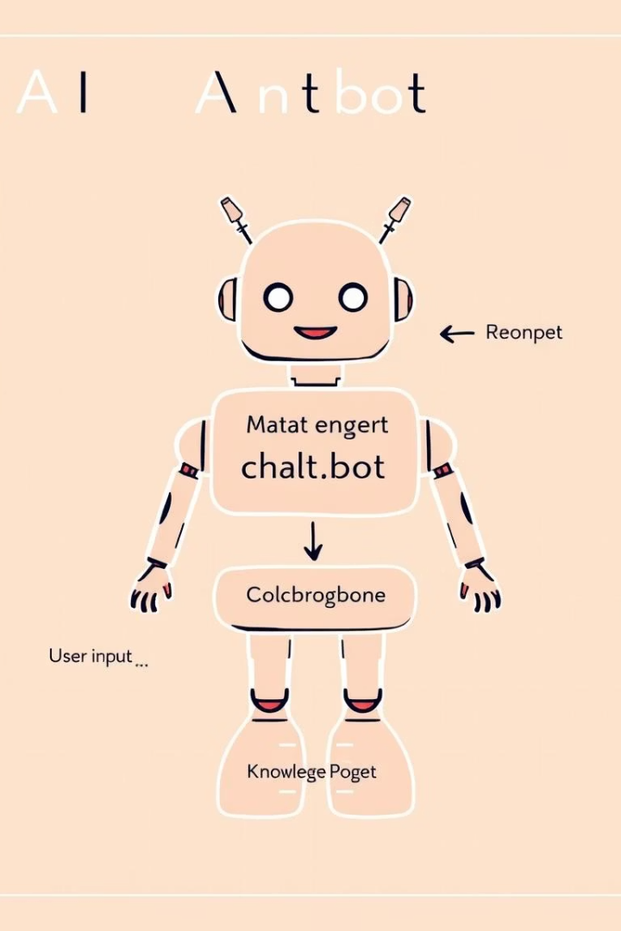
Technical Requirements
Software
Programming Language: Python.
NLP (Natural Language Programming).
LLMs
Gen AI using RAG.
Hardware
Server for chatbot hosting.
User devices.

Slide 8





Future Scope & Development
Expansion
New subjects and exam formats
Integration
Learning management systems
Personalization
Study plan generation
Accessibility
Voice-based interaction

Slide 9

Conclusion: Questor's Impact
Questor offers an innovative approach for exam preparation. It has the potential to democratize access to quality study resources. We are committed to continuous improvement and expansion.

Slide 10

Thank You

